Slide 1
Solving Recurrences

Slide 2
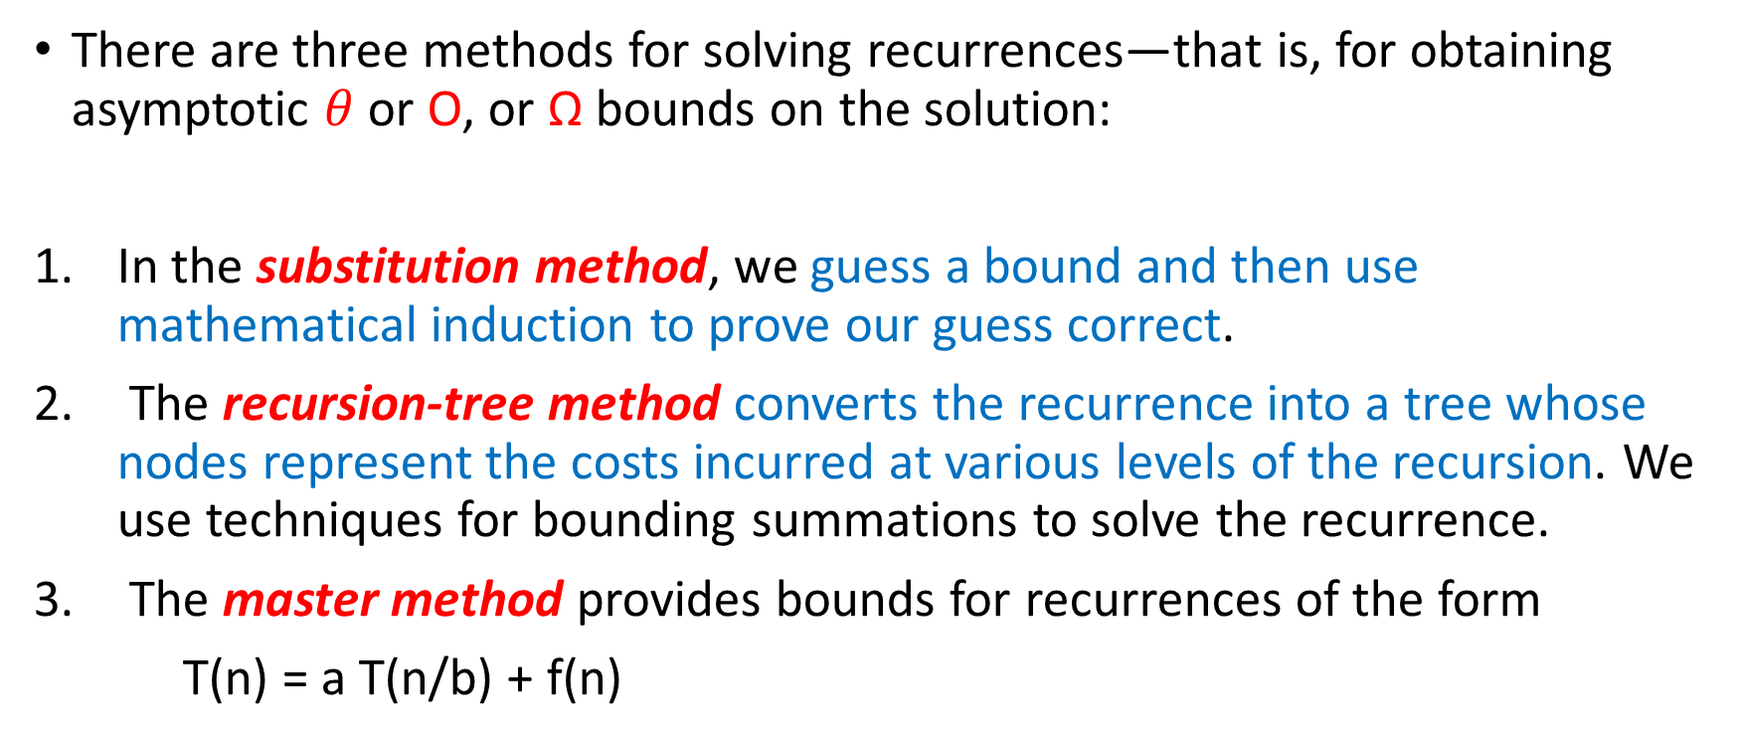
Methods For Solving Recurrences
There are three methods for solving recurrences—that is, for obtaining asymptotic $θ$ or O, or Ω bounds on the solution:
In the substitution method, we guess a bound and then use mathematical induction to prove our guess correct.
The recursion-tree method converts the recurrence into a tree whose nodes represent the costs incurred at various levels of the recursion. We use techniques for bounding summations to solve the recurrence.
The master method provides bounds for recurrences of the form
T(n) = a T(n/b) + f(n)

Slide 3
The Substitution Method

Slide 4
The substitution method for solving recurrences comprises two steps:
1. Guess the form of the solution.
2. Use mathematical induction to find the constants and show that the solution works.
We substitute the guessed solution for the function when applying the inductive hypothesis to smaller values (ex. n/2).
We can use the substitution method to establish either upper or lower bounds on a recurrence.

Slide 5
Substitution method
Guess a solution
T(n) = O(g(n))
Induction goal: apply the definition of the asymptotic notation
T(n) ≤ c g(n), for some c > 0 and n ≥ n₀
Induction hypothesis: T(k) ≤ c g(k) for all k < n
Prove the induction goal
Use the induction hypothesis to find some values of the constants c and n₀ for which the induction goal holds

Slide 6
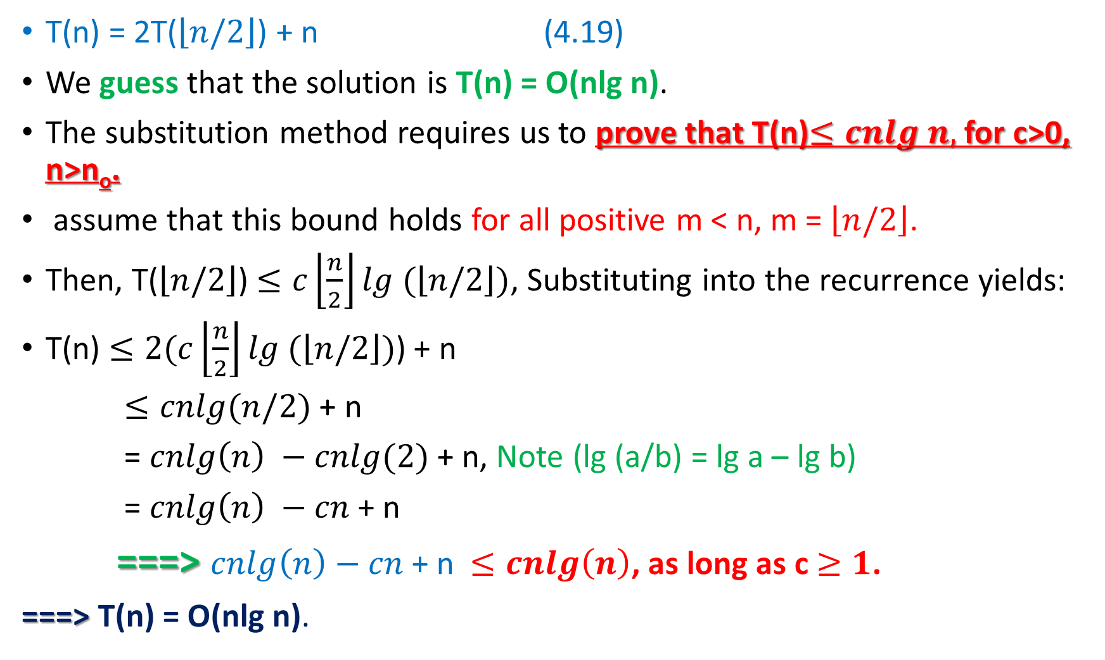
Example 1
T(n) = 2T($\left\lfloor n/2\right\rfloor$) + n (4.19)
We guess that the solution is T(n) = O(nlg n).
The substitution method requires us to prove that T(n)$≤cnlg n,$ for c>0, n>n_{o}.
assume that this bound holds for all positive m < n, m = $\left\lfloor n/2\right\rfloor$.
Then, T($\left\lfloor n/2\right\rfloor$) $≤c\left\lfloor \frac{n}{2}\right\rfloor lg (\left\lfloor n/2\right\rfloor )$, Substituting into the recurrence yields:
T(n) $≤2(c\left\lfloor \frac{n}{2}\right\rfloor lg (\left\lfloor n/2\right\rfloor )$) + n
$≤cnlg(n/2)$ + n
= $cnlg\left(n\right) −cnlg⁡(2)$ + n, Note (lg (a/b) = lg a – lg b)
= $cnlg\left(n\right) −cn$ + n
===> $cnlg\left(n\right)−cn$ + n $≤cnlg\left(n\right)$, as long as c $≥1$.
===> T(n) = O(nlg n).

Slide 7
Example 2
T(n) = T(n-1) + n
Guess: T(n) = O(n²)
Induction goal: T(n) ≤ c n², for some c and n ≥ n₀
Induction hypothesis: T(n-1) ≤ c(n-1)²
Proof of induction goal:
T(n) = T(n-1) + n ≤ c (n-1)² + n
= cn² – (2cn – c - n) ≤ cn²
if: 2cn – c – n ≥ 0 ⇔ c ≥ n/(2n-1) ⇔ c ≥ 1/(2 – 1/n)
For n ≥ 1 ⇒ 2 – 1/n ≥ 1 ⇒ any c ≥ 1 will work

Slide 8
Example 3: Binary Search
T(n) = 1 + T(n/2)
Guess: T(n) = O(lgn)
Induction goal: T(n) ≤ c lgn, for some c and n ≥ n₀
Induction hypothesis: T(n/2) ≤ c lg(n/2)
Proof of induction goal:
T(n) = T(n/2) + 1 ≤ c lg(n/2) + 1
= c lgn – c + 1 ≤ c lgn
if: c-1 ≥ 0, c ≥ 1

Slide 9
The Recursion Tree Method
Although we can use the substitution method to provide a proof that a solution to a recurrence is correct, we might have trouble coming up with a good guess.
In a recursion tree, each node represents the cost of a single subproblem somewhere in the set of recursive function invocations.
We sum the costs within each level of the tree to obtain a set of per-level costs, and then we sum all the per-level costs to determine the total cost of all levels of the recursion.

Slide 10
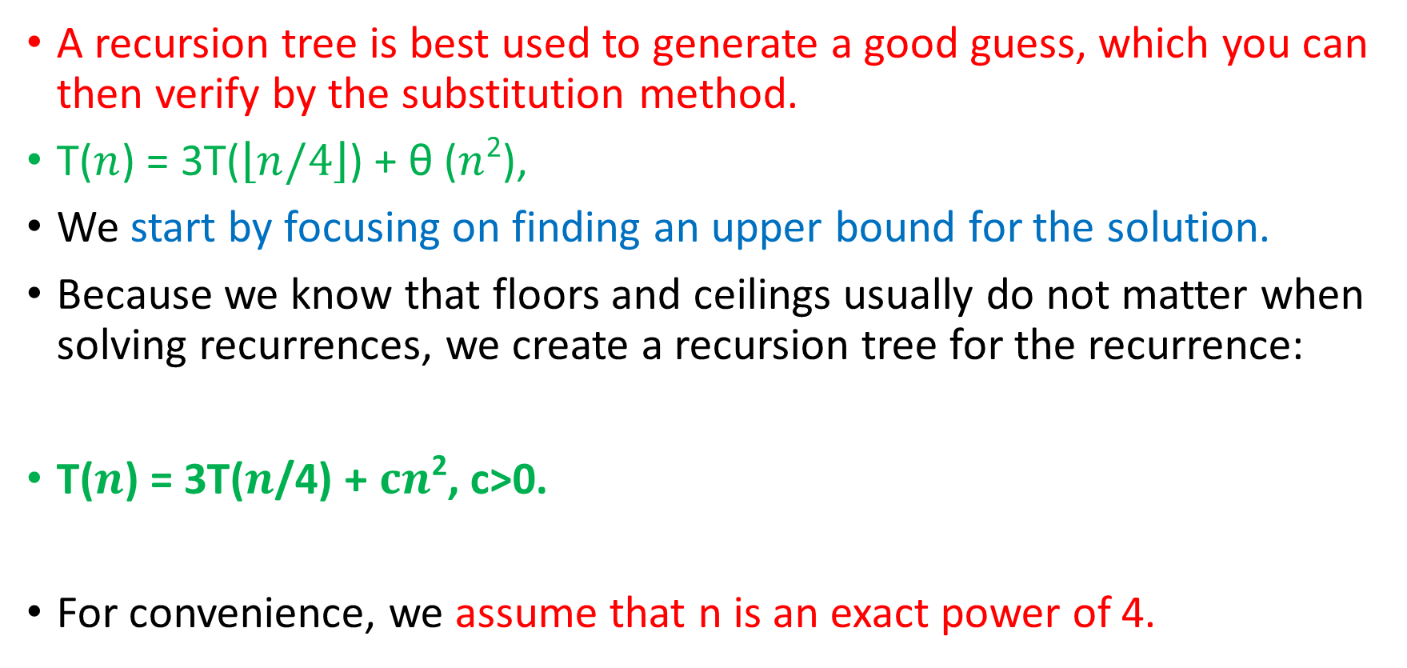
Example
A recursion tree is best used to generate a good guess, which you can then verify by the substitution method.
T($n$) = 3T($\left\lfloor n/4\right\rfloor$) + θ ($n$²),
We start by focusing on finding an upper bound for the solution.
Because we know that floors and ceilings usually do not matter when solving recurrences, we create a recursion tree for the recurrence:
T($n$) = 3T($n$/4) + $cn$², c>0.
For convenience, we assume that n is an exact power of 4.

Slide 13
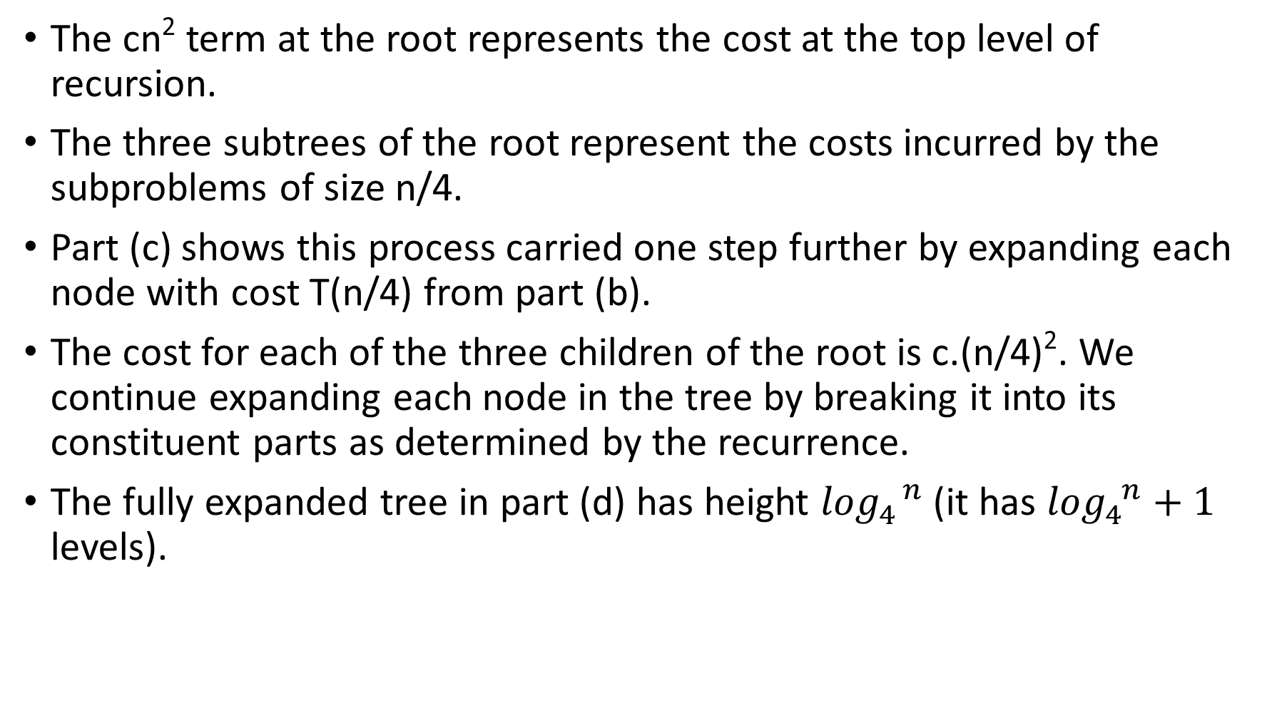
The cn² term at the root represents the cost at the top level of recursion.
The three subtrees of the root represent the costs incurred by the subproblems of size n/4.
Part (c) shows this process carried one step further by expanding each node with cost T(n/4) from part (b).
The cost for each of the three children of the root is c.(n/4)². We continue expanding each node in the tree by breaking it into its constituent parts as determined by the recurrence.
The fully expanded tree in part (d) has height $\log_{4}^{ n}$ (it has $\log_{4}^{ n}+1$ levels).

Slide 14
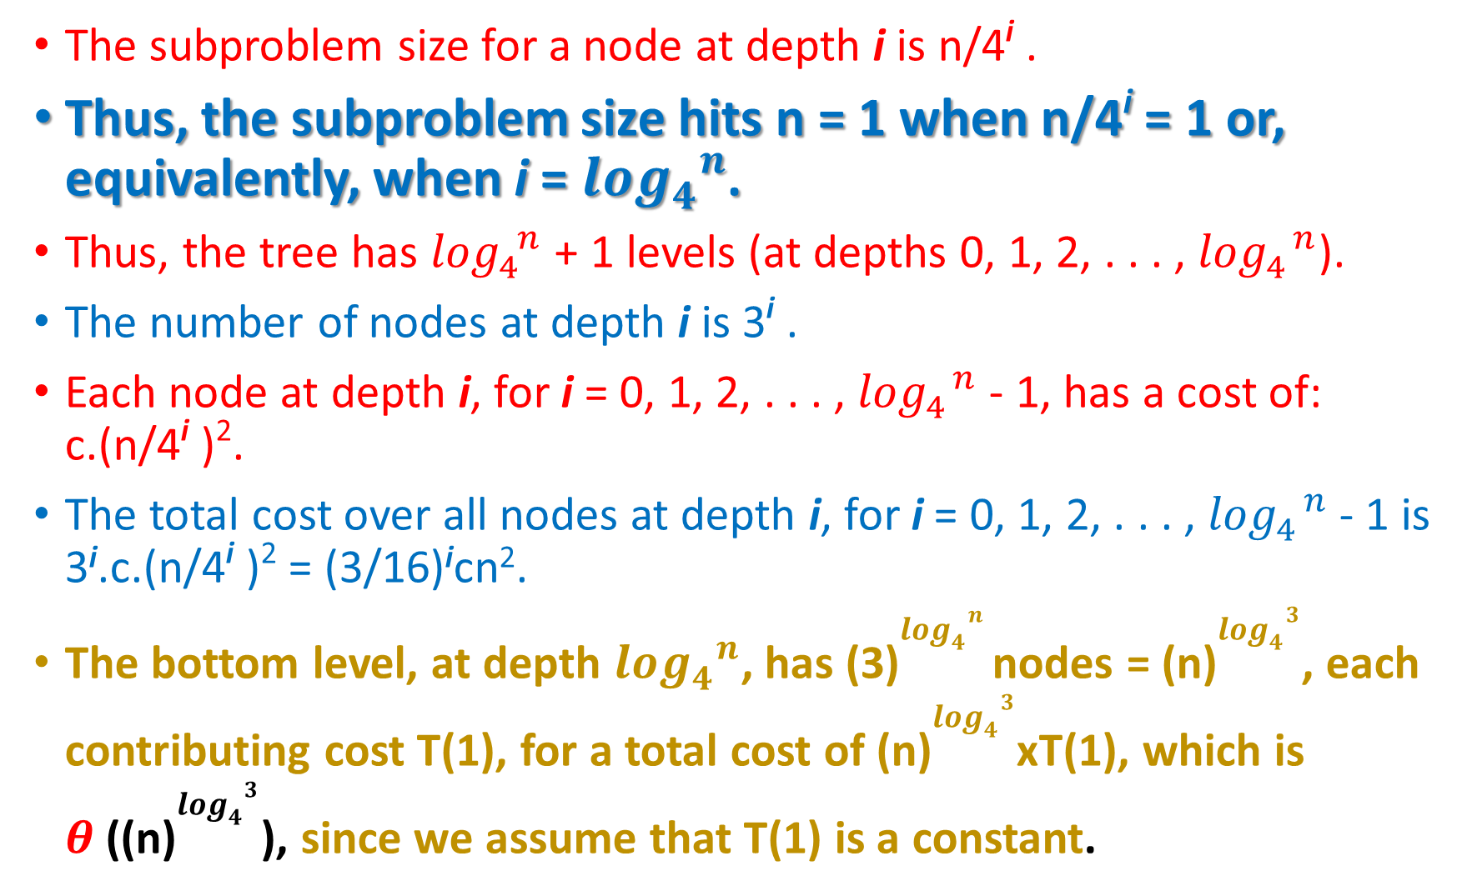
The subproblem size for a node at depth i is n/4^{i} .
Thus, the subproblem size hits n = 1 when n/4^{i} = 1 or, equivalently, when i = $\log_{4}^{ n}$.
Thus, the tree has $\log_{4}^{ n}$ + 1 levels (at depths 0, 1, 2, . . . , $\log_{4}^{ n}$).
The number of nodes at depth i is 3^{i} .
Each node at depth i, for i = 0, 1, 2, . . . , $\log_{4}^{ n}$ - 1, has a cost of: c.(n/4^{i} )².
The total cost over all nodes at depth i, for i = 0, 1, 2, . . . , $\log_{4}^{ n}$ - 1 is 3^{i}.c.(n/4^{i} )² = (3/16)^{i}cn².
The bottom level, at depth $\log_{4}^{ n}$, has (3)$\log_{4}^{ n}$nodes = (n)$\log_{4}^{ 3}$, each contributing cost T(1), for a total cost of (n)$\log_{4}^{ 3}$xT(1), which is $θ$((n)$\log_{4}^{ 3}$), since we assume that T(1) is a constant.

Slide 16
By applying A.6

Slide 17

Thus, we have derived a guess of T(n) = O(n²) for our original recurrence T($n$) = 3T($\left\lfloor n/4\right\rfloor$) + θ ($n$²).

Slide 18
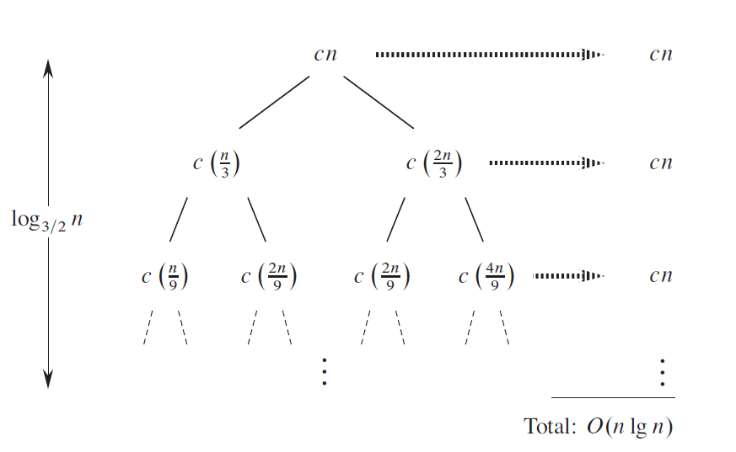

Slide 19

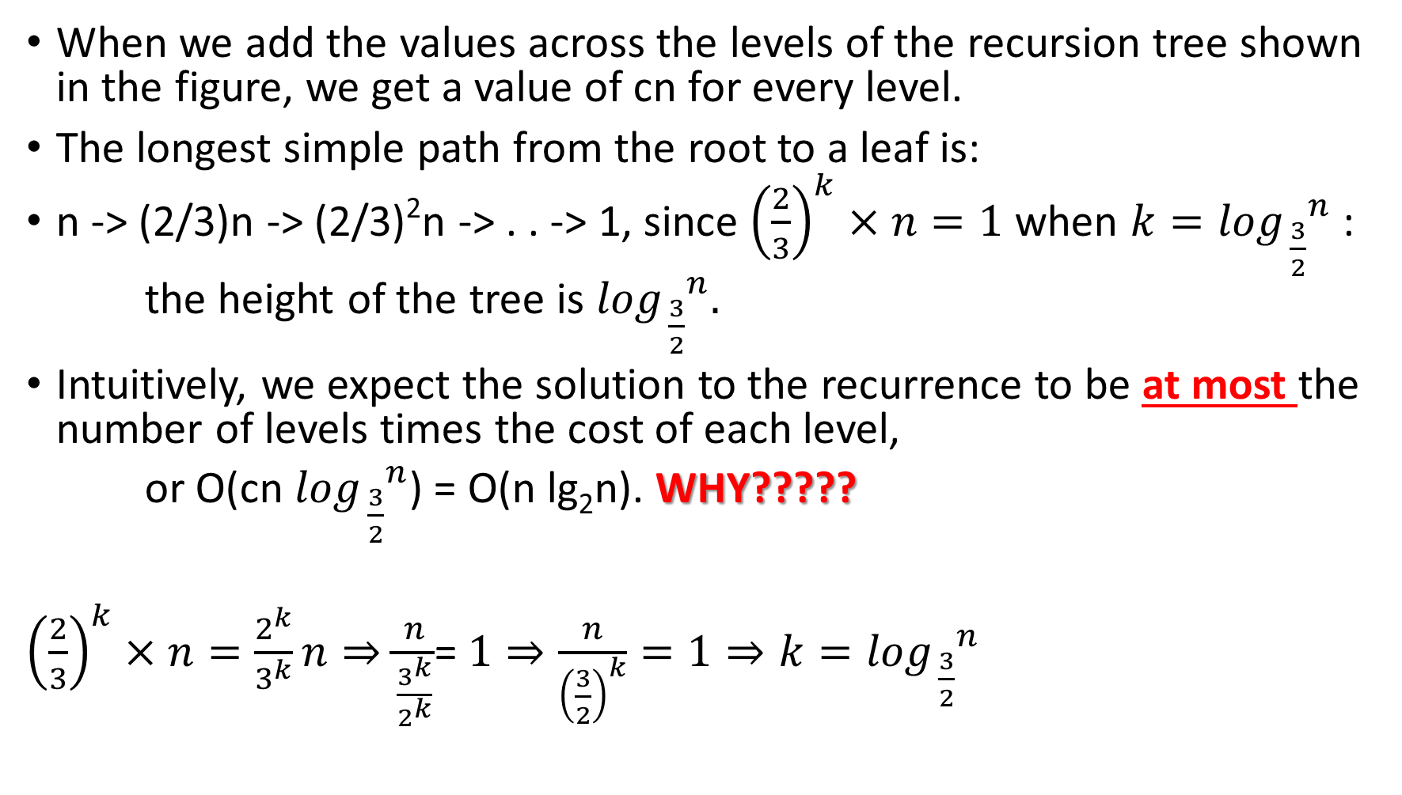
When we add the values across the levels of the recursion tree shown in the figure, we get a value of cn for every level.
The longest simple path from the root to a leaf is:
n -> (2/3)n -> (2/3)²n -> . . -> 1, since ${\left(\frac{2}{3}\right)}^{k}×n=1$ when $k=\log_{ \frac{3}{2}}^{ n}$ :
the height of the tree is $\log_{ \frac{3}{2}}^{ n}.$
Intuitively, we expect the solution to the recurrence to be at most the number of levels times the cost of each level,
or O(cn $\log_{ \frac{3}{2}}^{ n}$) = O(n lg₂n). WHY?????
${\left(\frac{2}{3}\right)}^{k}×n=\frac{2^{k}}{3^{k}}n⇒\frac{n}{\frac{3^{k}}{2^{k}}}$= $1⇒\frac{n}{{\left(\frac{3}{2}\right)}^{k}}=1⇒k=\log_{ \frac{3}{2}}^{ n}$

Slide 20
lg(2n/2/3/2) =
lg(n/(3/2)) )

Slide 21
The master method for solving recurrences
The master method provides a “cookbook” method for solving recurrences of the form:
T(n) = aT(n/b) + f(n), ……………………….(4.20)
where, a>=1 and b>1 are constants, f(n) asymptotically positive function.
To use the master method, you will need to memorize three cases, but then you will be able to solve many recurrences quite easily, often without pencil and paper.

Slide 22
The recurrence (4.20) describes the running time of an algorithm that divides a problem of size n into a subproblems, each of size n=b, where a and b are positive constants.
The a subproblems are solved recursively, each in time T(n/b).
The function f(n) encompasses the cost of dividing the problem and combining the results of the subproblems.

Slide 23
Theorem 4.1 (Master theorem)
T(n) = a.T(n/b) + f(n), ……………………….(4.20)
where, T(n) be defined on the nonnegative integers, a>=1 and b>1 are constants, f(n) asymptotically positive function.

Slide 24
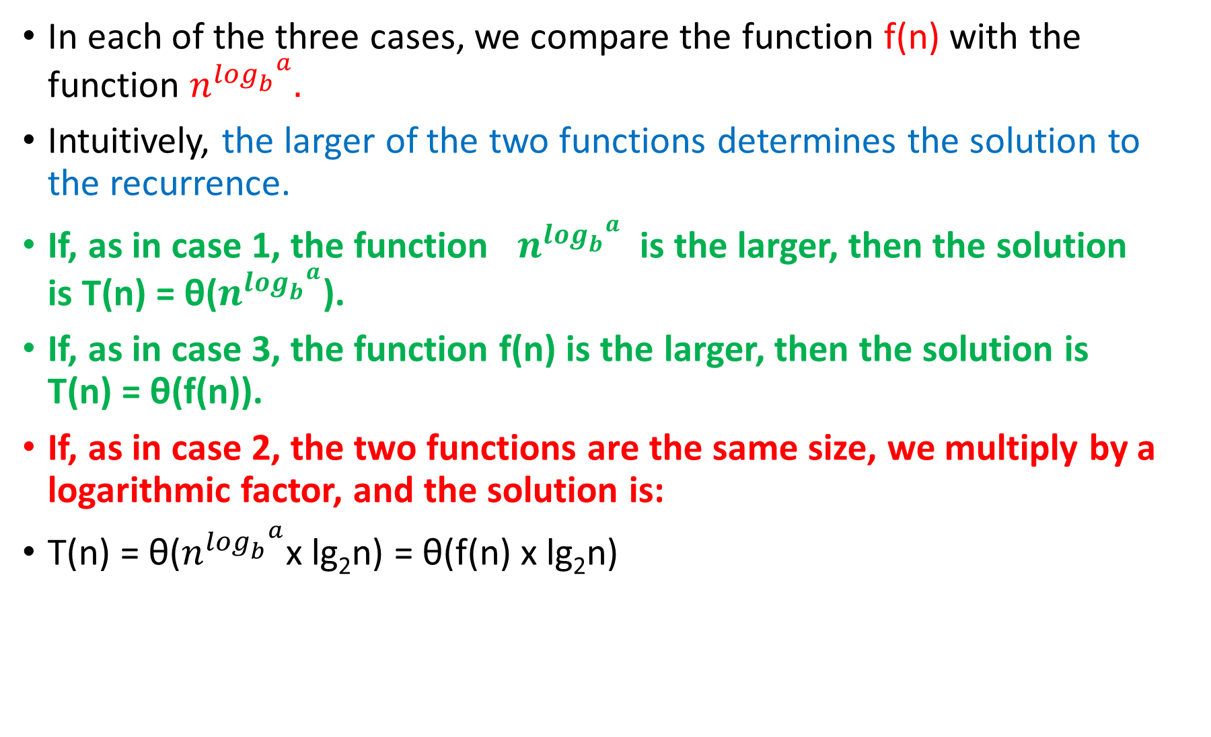
In each of the three cases, we compare the function f(n) with the function $n^{\log_{b}^{ a}}.$
Intuitively, the larger of the two functions determines the solution to the recurrence.
If, as in case 1, the function $n^{\log_{b}^{ a}}$ is the larger, then the solution is T(n) = θ($n^{\log_{b}^{ a}}$).
If, as in case 3, the function f(n) is the larger, then the solution is T(n) = θ(f(n)).
If, as in case 2, the two functions are the same size, we multiply by a logarithmic factor, and the solution is:
T(n) = θ($n^{\log_{b}^{ a}}$x lg₂n) = θ(f(n) x lg₂n)

Slide 25
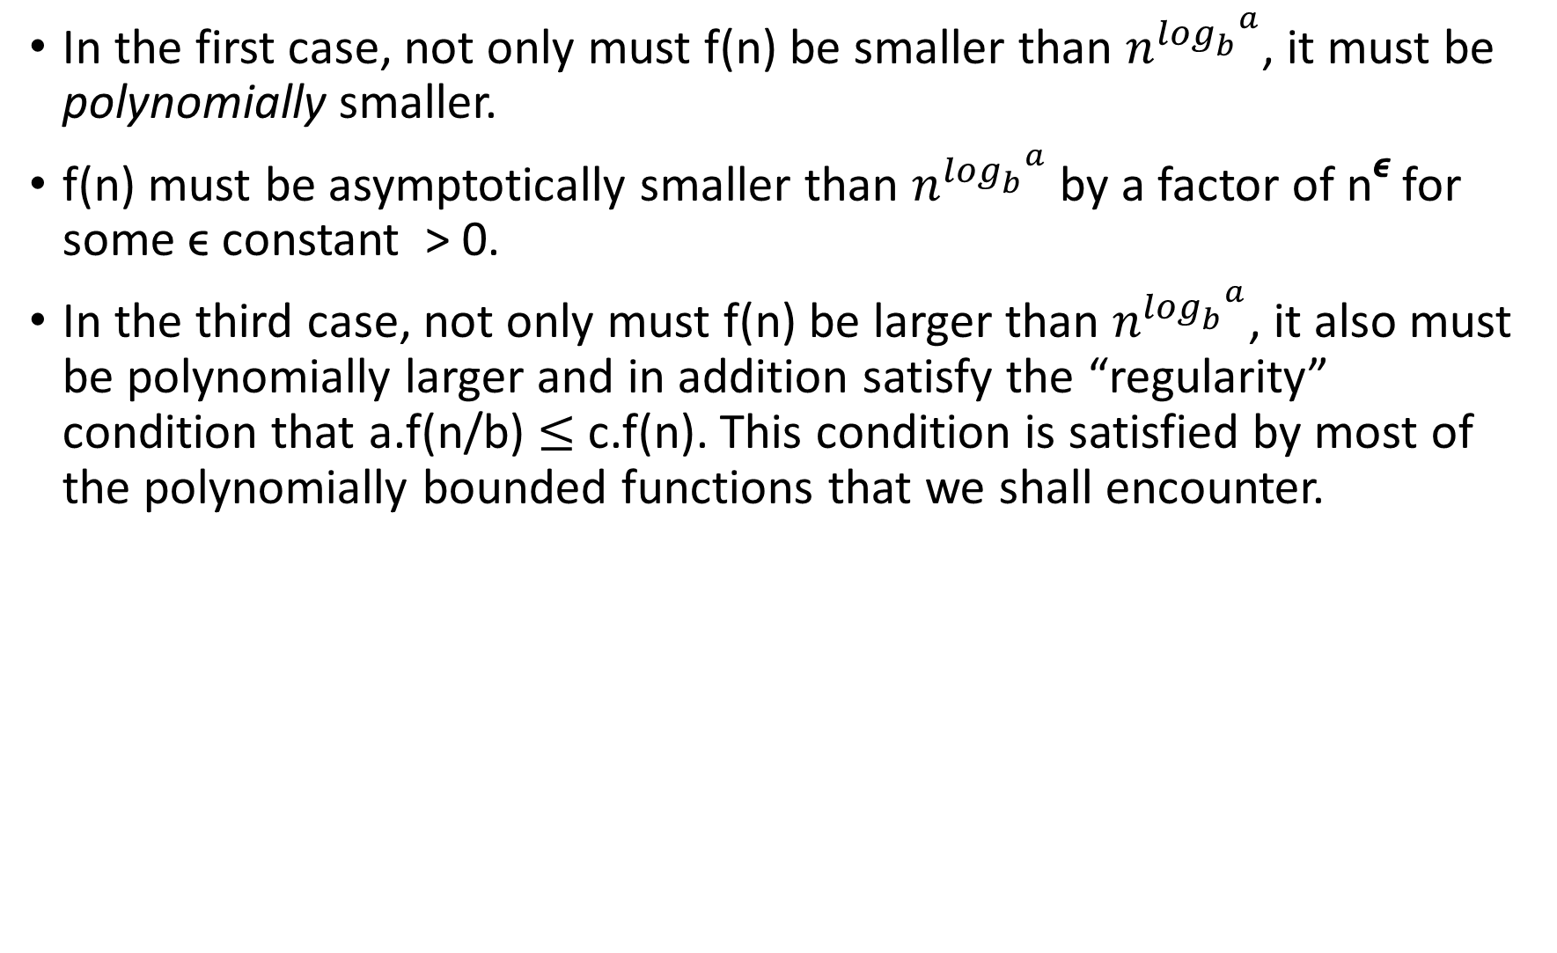
In the first case, not only must f(n) be smaller than $n^{\log_{b}^{ a}}$, it must be polynomially smaller.
f(n) must be asymptotically smaller than $n^{\log_{b}^{ a}}$ by a factor of n^{ϵ} for some ϵ constant > 0.
In the third case, not only must f(n) be larger than $n^{\log_{b}^{ a}}$, it also must be polynomially larger and in addition satisfy the “regularity” condition that a.f(n/b) $≤$ c.f(n). This condition is satisfied by most of the polynomially bounded functions that we shall encounter.

Slide 26
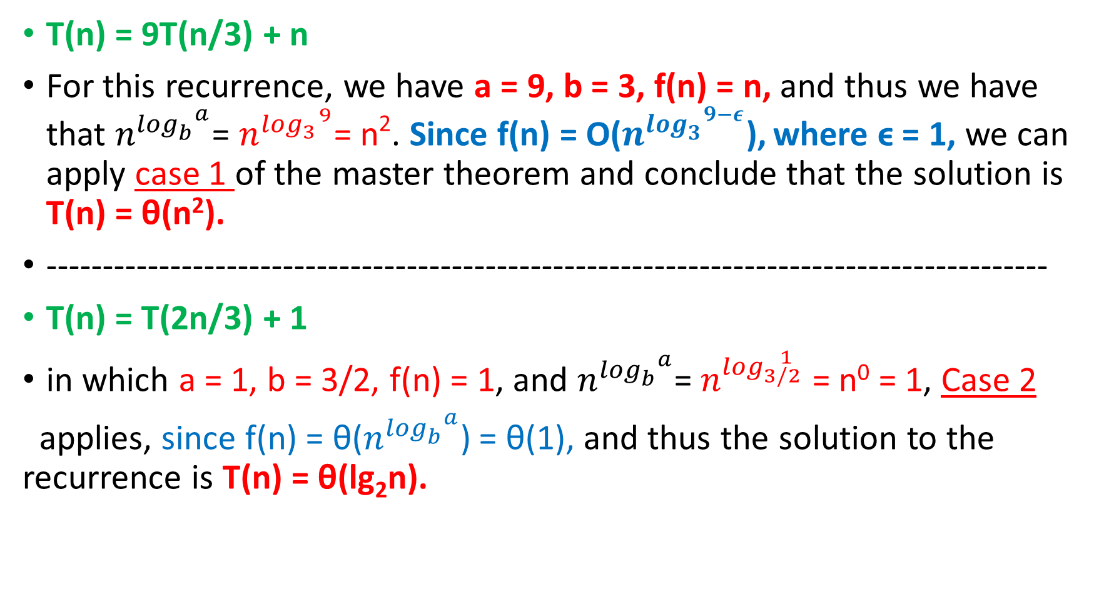
Examples
T(n) = 9T(n/3) + n
For this recurrence, we have a = 9, b = 3, f(n) = n, and thus we have that $n^{\log_{b}^{ a}}$= $n^{\log_{3}^{ 9}}$= n². Since f(n) = O($n^{\log_{3}^{ 9−ε}}$), where ϵ = 1, we can apply case 1 of the master theorem and conclude that the solution is T(n) = θ(n²).
-----------------------------------------------------------------------------------------
T(n) = T(2n/3) + 1
in which a = 1, b = 3/2, f(n) = 1, and $n^{\log_{b}^{ a}}$= $n^{\log_{3/2}^{ 1}}$ = n⁰ = 1, Case 2
applies, since f(n) = θ($n^{\log_{b}^{ a}}$) = θ(1), and thus the solution to the recurrence is T(n) = θ(lg₂n).

Slide 27
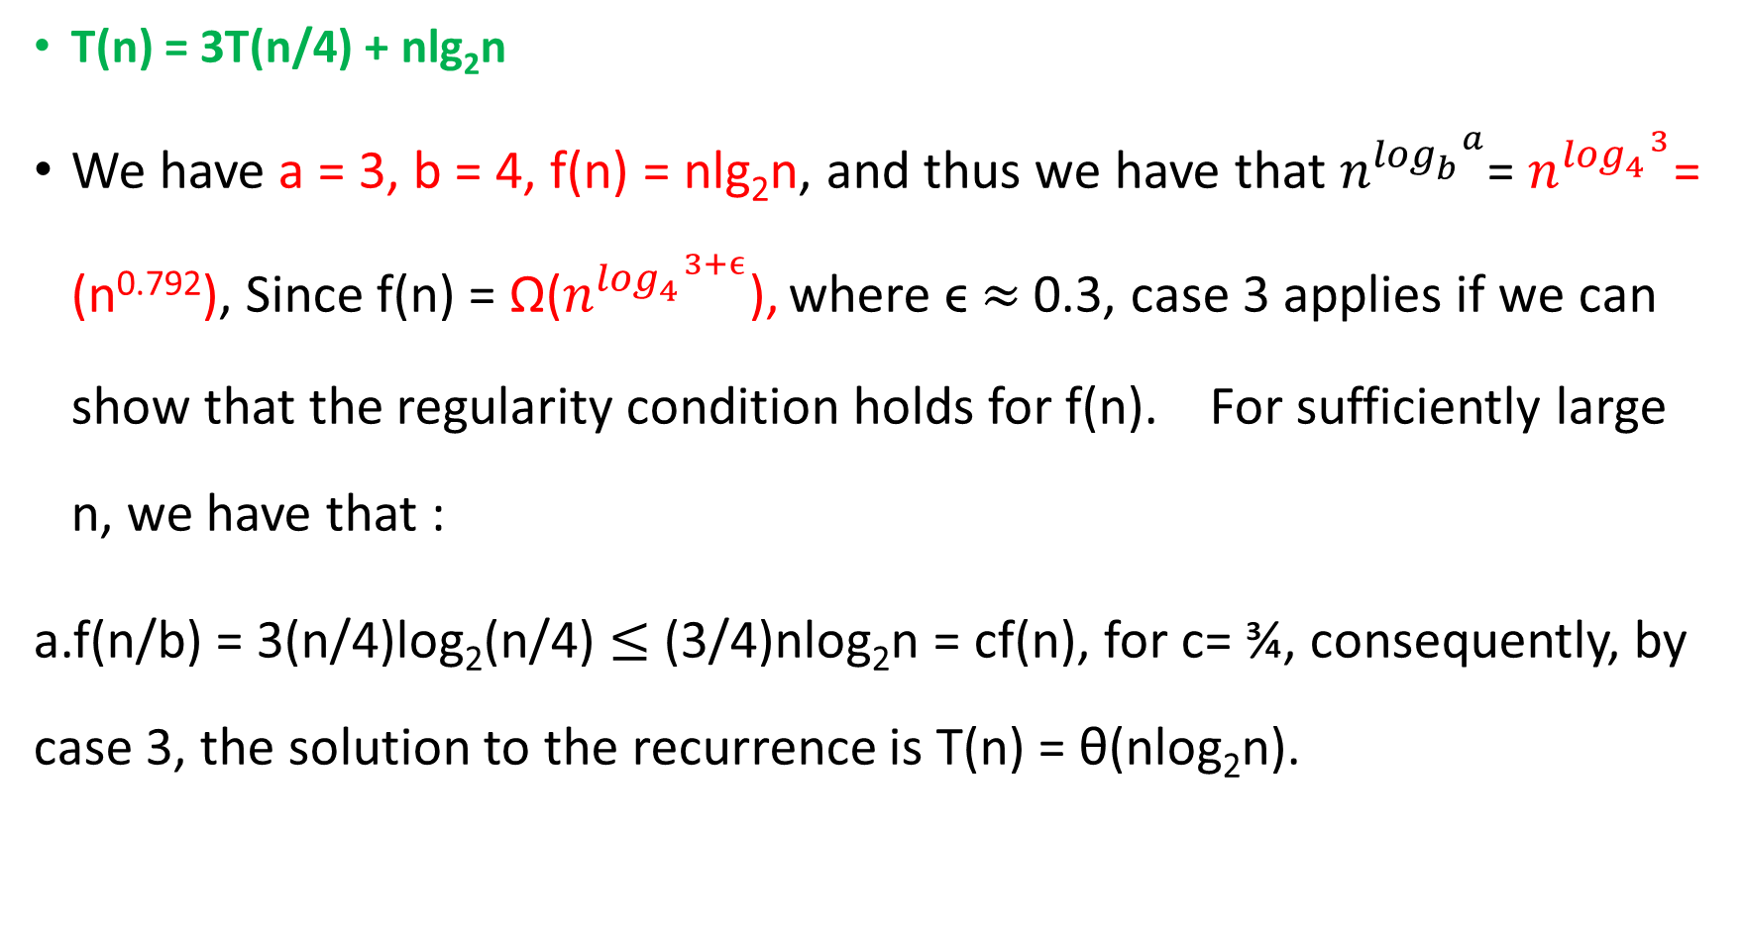
Examples
T(n) = 3T(n/4) + nlg₂n
We have a = 3, b = 4, f(n) = nlg₂n, and thus we have that $n^{\log_{b}^{ a}}$= $n^{\log_{4}^{ 3}}$= (n^{0.792}), Since f(n) = Ω($n^{\log_{4}^{ 3+ϵ}}$), where ϵ $≈$ 0.3, case 3 applies if we can show that the regularity condition holds for f(n). For sufficiently large n, we have that :
a.f(n/b) = 3(n/4)log₂(n/4) $≤$(3/4)nlog₂n = cf(n), for c= ¾, consequently, by case 3, the solution to the recurrence is T(n) = θ(nlog₂n).

Slide 28
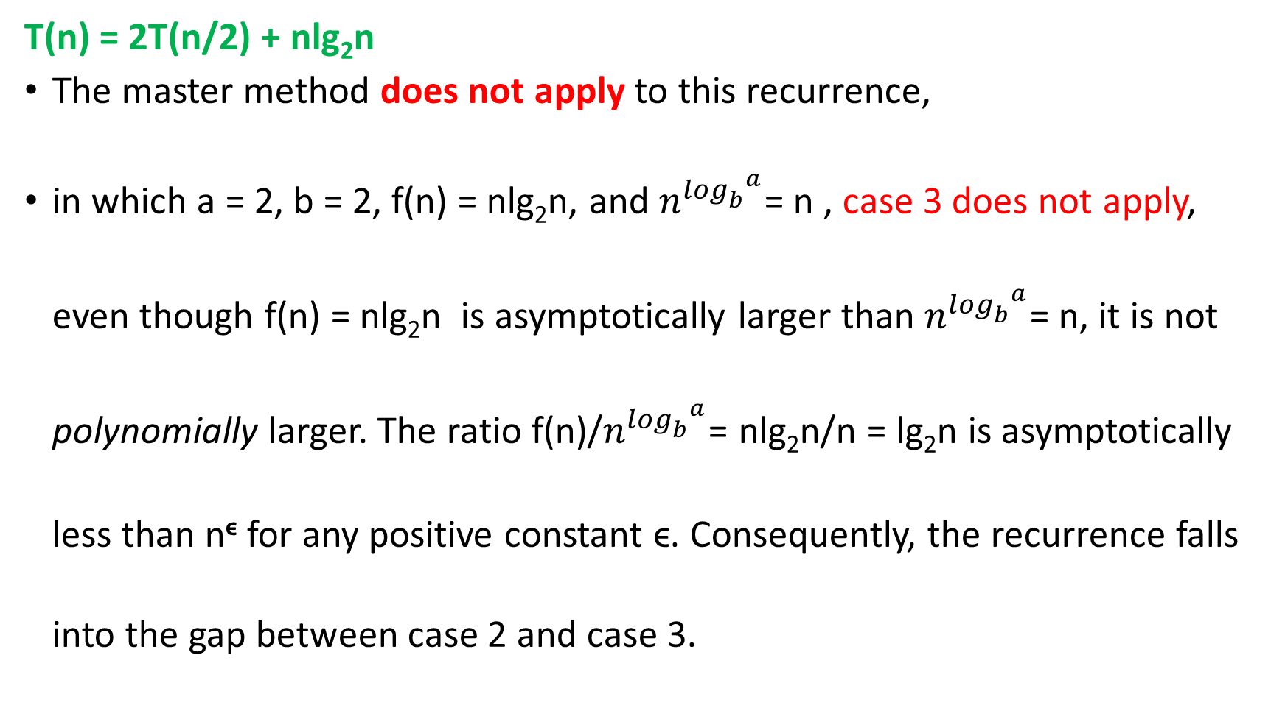
T(n) = 2T(n/2) + nlg₂n
The master method does not apply to this recurrence,
in which a = 2, b = 2, f(n) = nlg₂n, and $n^{\log_{b}^{ a}}$= n , case 3 does not apply, even though f(n) = nlg₂n is asymptotically larger than $n^{\log_{b}^{ a}}$= n, it is not polynomially larger. The ratio f(n)/$n^{\log_{b}^{ a}}$= nlg₂n/n = lg₂n is asymptotically less than n^{ϵ} for any positive constant ϵ. Consequently, the recurrence falls into the gap between case 2 and case 3.

Slide 29
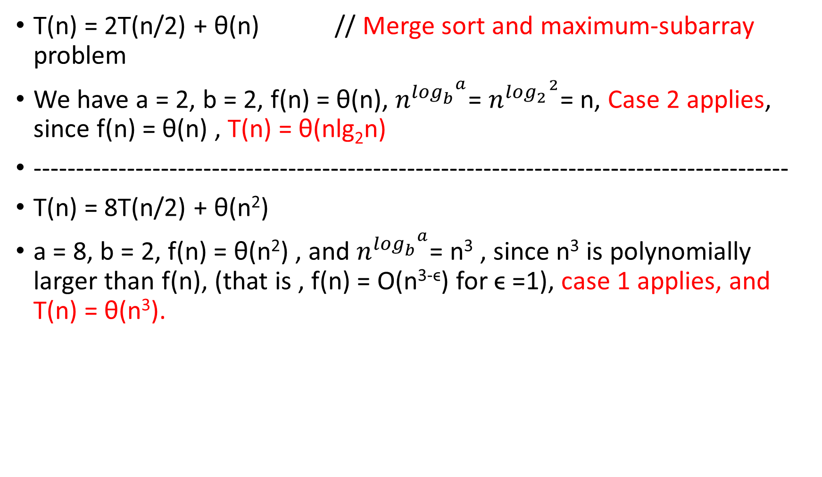
Examples
T(n) = 2T(n/2) + θ(n) // Merge sort and maximum-subarray problem
We have a = 2, b = 2, f(n) = θ(n), $n^{\log_{b}^{ a}}$= $n^{\log_{2}^{ 2}}$= n, Case 2 applies, since f(n) = θ(n) , T(n) = θ(nlg₂n)
-----------------------------------------------------------------------------------------
T(n) = 8T(n/2) + θ(n²)
a = 8, b = 2, f(n) = θ(n²) , and $n^{\log_{b}^{ a}}$= n³ , since n³ is polynomially larger than f(n), (that is , f(n) = O(n^{3-ϵ}) for ϵ =1), case 1 applies, and T(n) = θ(n³).

Slide 30

T(n) = 7T(n/2) + θ(n²) running time of Strassen’s algorithm
a = 7, b = 2, f(n) = θ(n²) , and $n^{\log_{b}^{ a}}$= $n^{\log_{2}^{ 7}}$, 2.80 < lg7 < 2.81,
f(n) = O($n^{\log_{2}^{ 7−ϵ}}$) for ϵ =0.8. O(n^{2.6})
Again, case 1 applies, and we have the solution T(n) = θ($n^{\log_{2}^{ 7}}$).

